Slide 1

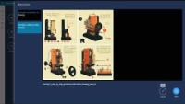
ENHANCE SUPPLY CHAIN VISIBILITY
Improve production execution
Reimagine Production Execution
New Production Execution user interface
Guides integrated into production steps
Easier work order management
Clock in/Clock out
Real time execution tracking
Work order instructions
Guides integration
Dynamics 365 Supply Chain Management

